Slide 1
Online fraud detection analysis:
Introduction:
The introduction of online payment systems has helped a lot in the ease of payments. But, at the same time, it increased in payment frauds. Online payment frauds can happen with anyone using any payment system, especially while making payments using a credit card. That is why detecting online payment fraud is very important for credit card companies to ensure that the customers are not getting charged for the products and services they never paid.

Slide 2
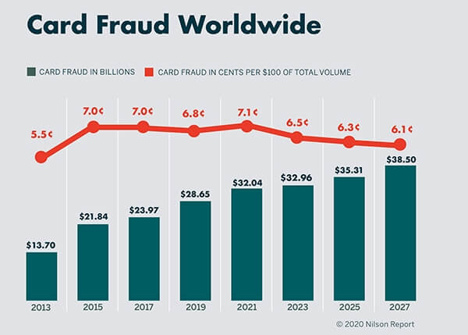
Payment card fraud affects everyone. Almost 30 billion dollars were lost worldwide in card fraud and identity theft only in 2019. Although financial institutions are locked in an escalating arms race against cybercriminals and scammers, losses still have to be accounted for. Consumers end up paying for money lost to fraud out of pocket, in the form of vendor and transaction fees. While corporations and governments spend more billions investigating and handling fraud cases.

Slide 3
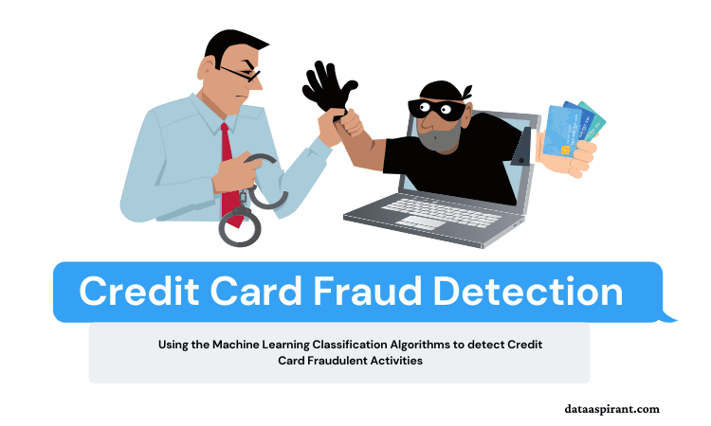
We Can use Machine Learning Algorithms To Detect Fraudulent Transactions:

Slide 4
Online Payments Fraud Detection with Machine Learning:
To identify online payment fraud with machine learning, we need to train a machine
learning model for classifying fraudulent and non-fraudulent payments. For this, we need a dataset containing information about online payment fraud, so that we can understand what type of transactions lead to fraud. For this task, I collected a dataset from Kaggle, which contains historical information about fraudulent transactions which can be used to detect fraud in online payments. Below are all the columns from the dataset I’m using here:
step: represents a unit of time where 1 step equals 1 hour
type: type of online transaction
amount: the amount of the transaction
nameOrig: customer starting the transaction
oldbalanceOrg: balance before the transaction
newbalanceOrig: balance after the transaction
nameDest: recipient of the transaction
oldbalanceDest: initial balance of recipient before the transaction
newbalanceDest: the new balance of recipient after the transaction
isFraud: fraud transaction

Slide 5
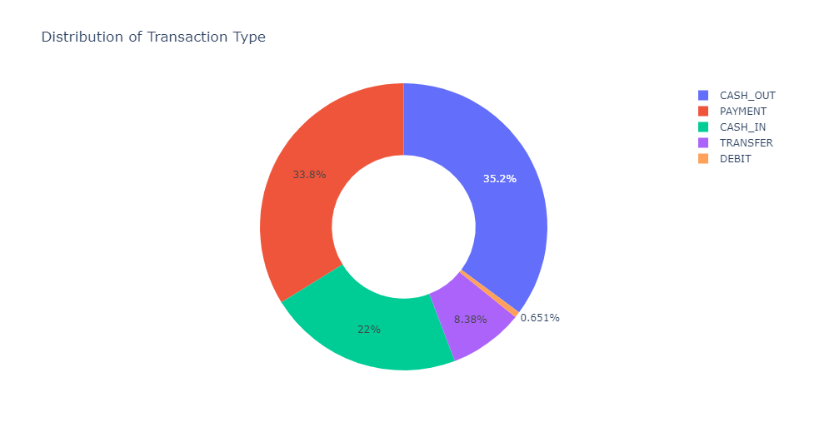
Payment Transaction Type:
So this dataset does not have any null values. Before moving forward, now, let’s have a look at the type of transaction mentioned in the dataset:

Slide 6
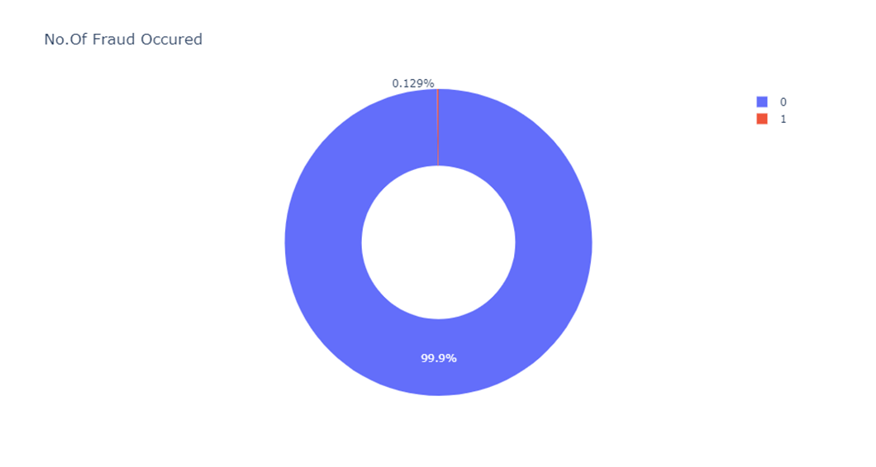
No.of fraud occurred:
During the transaction 99% fraud were not occurred we can see the percentage of fraud occurance below.

Slide 7
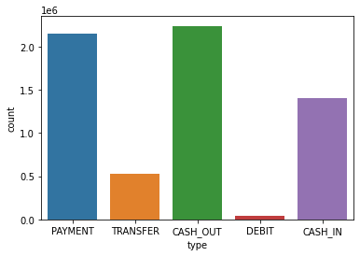
Bar Chart Shows the Type Of Transaction Made By The Customer:

Slide 8
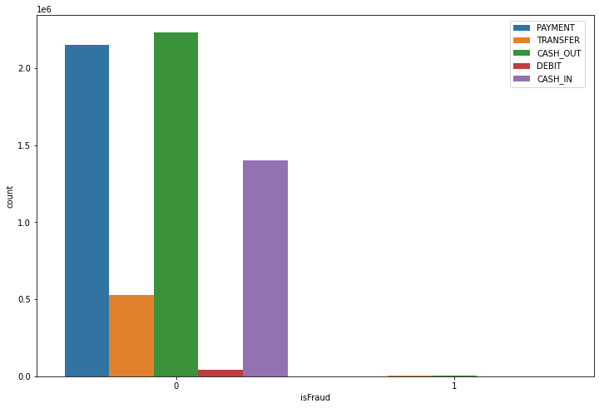
Fraudulent Transactions According To Payment Type:

Slide 9
Encoding Method:
Now let’s transform the categorical features into numerical. Here I will also transform the values of the isFraud column into No Fraud and Fraud labels to have a better understanding of the output:
Removing Outliers:
I have removed the outliers for all columns which contains outliers except Dependent Variable i.e. IsFraud column
Online Payments Fraud Detection Model:
Now let’s train a classification model to classify fraud and non-fraud transactions. Before training the model, I will split the data into training and test sets:
I have used Logistic regression, Decision tree classifier, Naïve Bayes Model and XGBoost classifier , here every model score is 99% accuracy.

Slide 10
Random Under Sampling:
I have used Random Under Sampling to balance the data set.
Usually Random Under Sampling is used to Under-sample the majority classes by randomly picking samples with or without replacement.
Actually the fraudulent data set contains 6354407 Non Fraudulent Transactions and 8213 are Fraudulent so there is an Imbalance in data set
For this we uses Random under sampler, It takes data randomly from majority class and balance the data with minority class.
Even after sampling the data the scores of model like Logistic regression,
Decision tree , XgBoost Classification scores remains same there is no any
in score accuracy.

Slide 11
Standard Scaler and Normalization:
I have used Standard Scaler method for all the models which I have used previously all models don’t have any change in their scores. except Decision Tree Score got over fitted.
Decision Tree score in Standard Scaler is ;
Train : 0.99
Test : 0.011
I have used normalization to check whether there is any changes in scores for all the models, But there is no any change in scores it remains same.
All models gives same scores ;
Train score : 0.99
Test score : 0.99

Slide 12
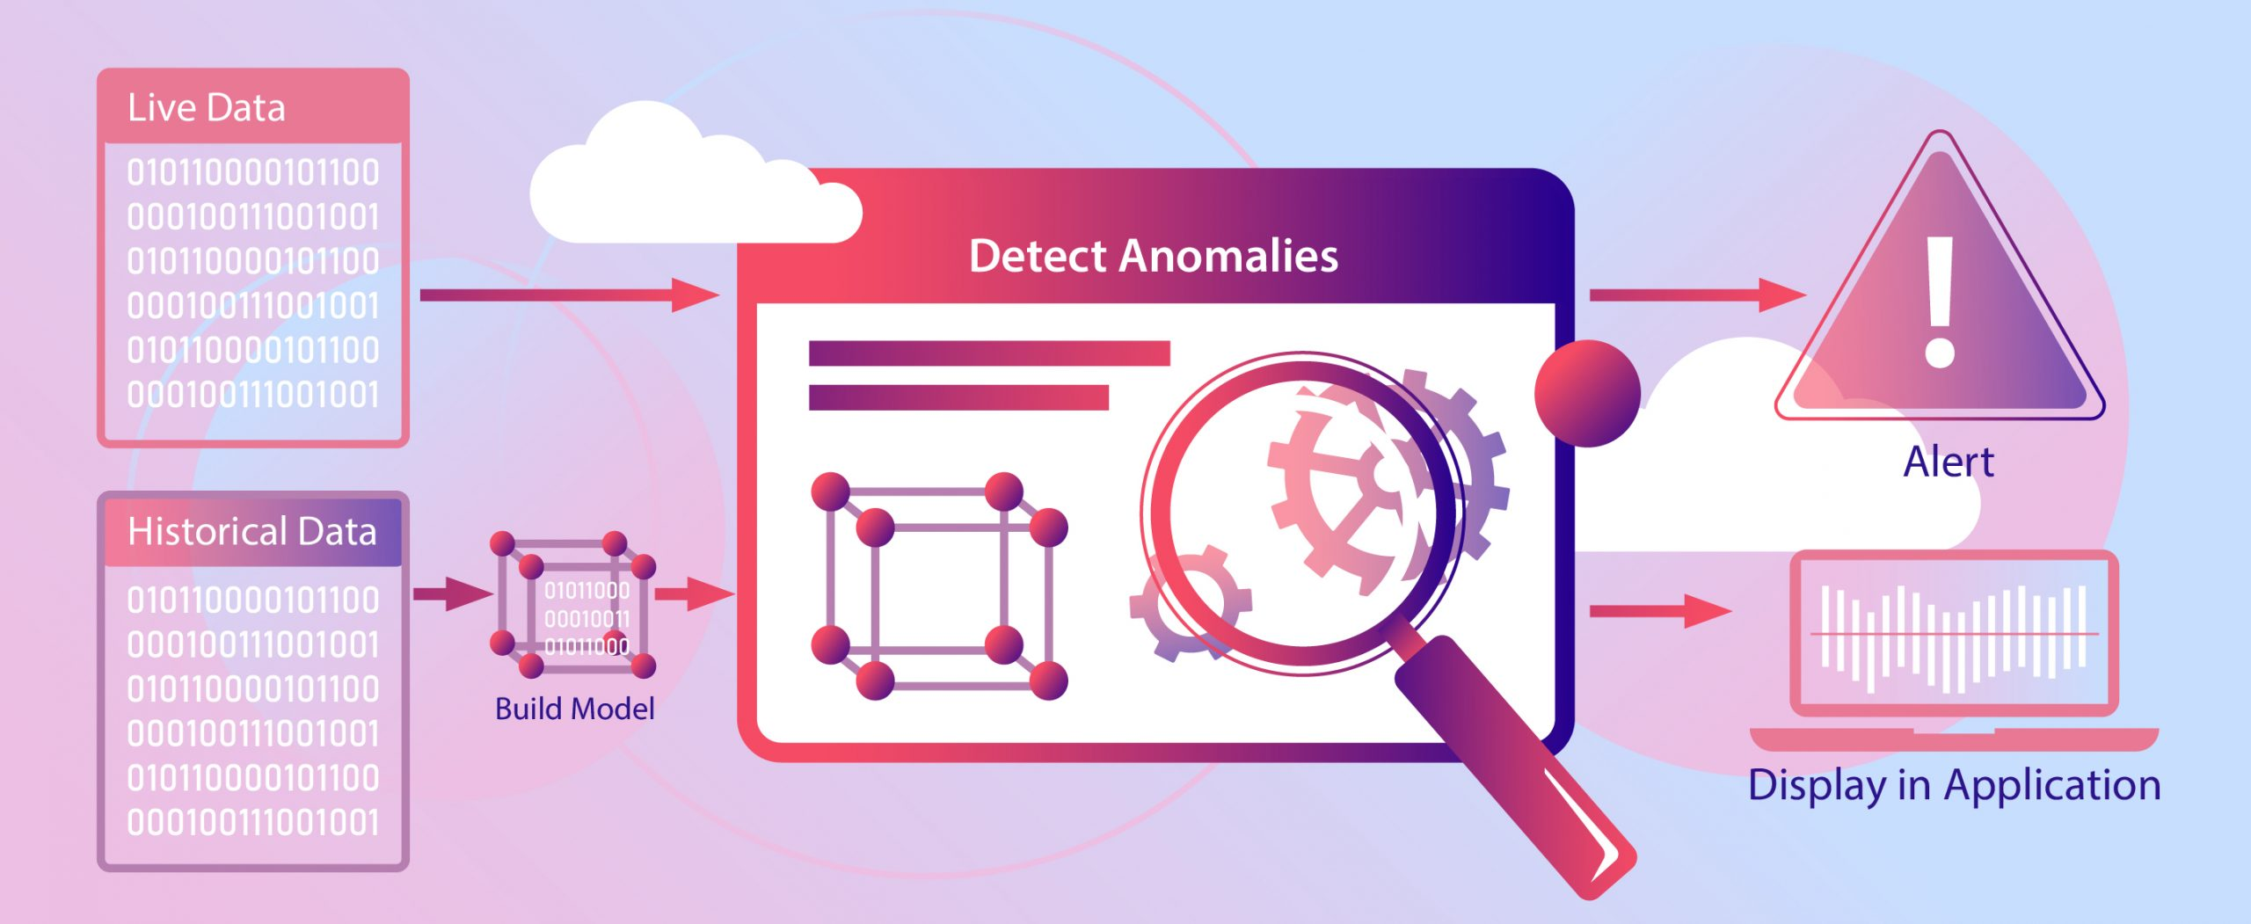
Summary:
So this is how we can detect online payments fraud with machine learning using Python. Detecting online payment frauds is one of the applications of data science in finance.

